Slide 1
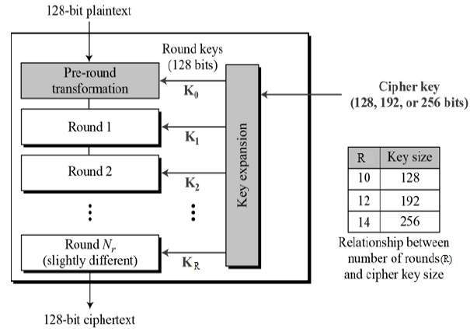
Mustansiriyah University Block Cipher Class: Third Year
Faculty of Engineering Advanced Encryption Standard Course name: Data Encryption
Computer Engineering Dep. Lecturer: Fatimah Al-Ubaidy
Block Cipher
The Advanced Encryption Standard (AES), also called Rijndael, is a symmetric block cipher with a block length of 128 bits and support for key lengths of 128, 192, and 256 bits. It was published by NIST (National Institute of Standards and Technology) in 2001. Here, we assume a key length of 128 bits, which is likely to be the one most commonly implemented.

Slide 2

Mustansiriyah University Block Cipher Class: Third Year
Faculty of Engineering Advanced Encryption Standard Course name: Data Encryption
Computer Engineering Dep. Lecturer: Fatimah Al-Ubaidy
AES Block Cipher
The AES Algorithm:
AES operates on a 4 × 4 column-wise order array of bytes, called the state. For instance, if there are 16 bytes, these bytes are represented as this two-dimensional array:
The key size used for an AES cipher specifies the number of transformation rounds that convert the plaintext into the ciphertext . The number of rounds are as follows:
10 rounds for 128-bit keys.
12 rounds for 192-bit keys.
14 rounds for 256-bit keys.
Each round consists of several processing steps, including one that depends on the encryption key itself. A set of reverse rounds are applied to transform ciphertext back into the original plaintext using the same encryption key.

Slide 3
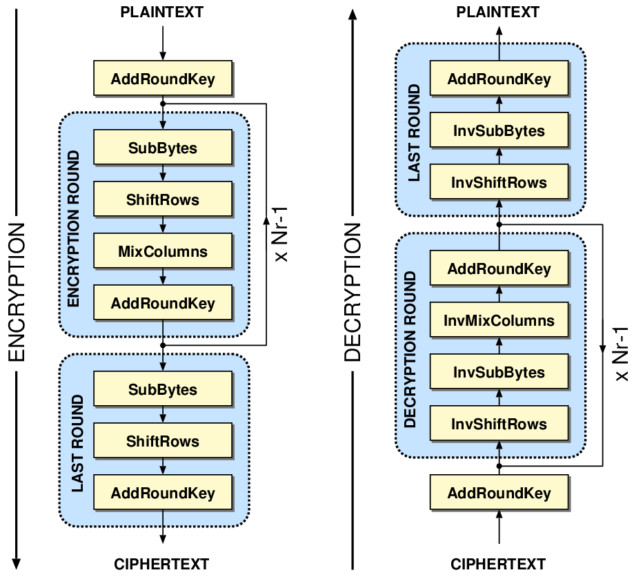
Mustansiriyah University Block Cipher Class: Third Year
Faculty of Engineering Advanced Encryption Standard Course name: Data Encryption
Computer Engineering Dep. Lecturer: Fatimah Al-Ubaidy
AES Block Cipher
The AES Encryption Algorithm:
The AES algorithm can be broken into three phases: the initial round, the main rounds, and the final round. All of the phases use the same sub-operations in different combinations as follows:
Initial Round
AddRoundKey
Main Rounds (1,2…Nr-1)
SubBytes
ShiftRows
MixColumns
AddRoundKey
Final Round (Nr)
SubBytes
ShiftRows
AddRoundKey
Note that in the above figure, KeyExpansion: round keys are derived from the cipher key using key expansion algorithm. AES requires a separate 128-bit round key block for each round plus one more.

Slide 4
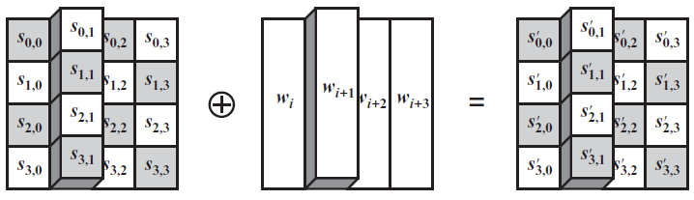
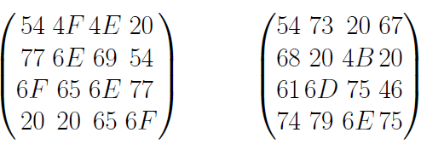
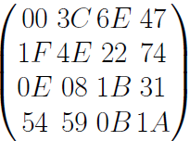
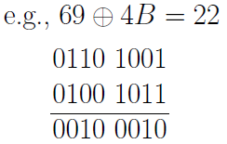

Mustansiriyah University Block Cipher Class: Third Year
Faculty of Engineering Advanced Encryption Standard Course name: Data Encryption
Computer Engineering Dep. Lecturer: Fatimah Al-Ubaidy
AES Block Cipher
AddRoundKey: In this operation, the 128 bits of State are bitwise XORed with the 128 bits of the round key. Here is an example where the first matrix is State, and the second matrix is the round key.
e.g.
=
$$$$

Slide 5
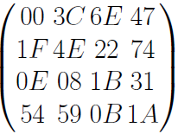
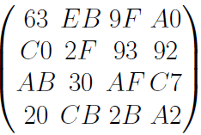
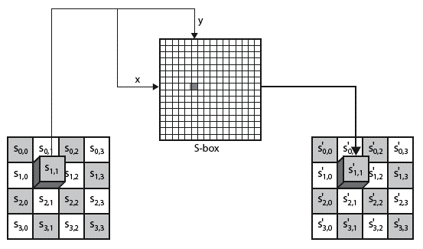
Mustansiriyah University Block Cipher Class: Third Year
Faculty of Engineering Advanced Encryption Standard Course name: Data Encryption
Computer Engineering Dep. Lecturer: Fatimah Al-Ubaidy
AES Block Cipher
SubBytes: A nonlinear substitution step where each entry (byte) of the current state matrix is substituted by a corresponding entry in the AES S-Box. For instance: byte (6E) is substituted by the entry of the S-Box in row 6 and column E, i.e., by (9F). (The byte input is broken into two 4-bit halves. The first half determines the row and the second half determines the column).
e.g.:
state = ⇒ S_box(State) =

Slide 6
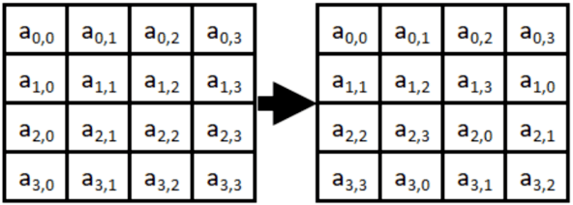
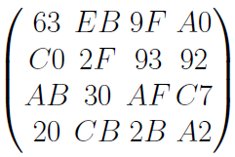
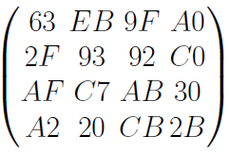
Mustansiriyah University Block Cipher Class: Third Year
Faculty of Engineering Advanced Encryption Standard Course name: Data Encryption
Computer Engineering Dep. Lecturer: Fatimah Al-Ubaidy
AES Encryption Cipher
ShiftRows: A transposition step where the four rows of the state are shifted cyclically to the left by offsets of 0, 1, 2, and 3.
e.g.:
e.g.:
⇒

Slide 7
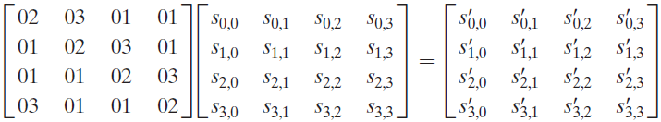
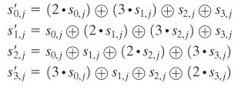
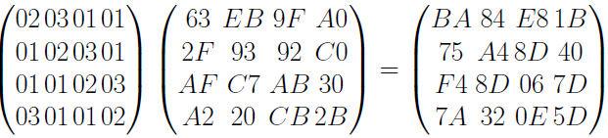
Mustansiriyah University Block Cipher Class: Third Year
Faculty of Engineering Advanced Encryption Standard Course name: Data Encryption
Computer Engineering Dep. Lecturer: Fatimah Al-Ubaidy
AES Block Cipher
MixColumns: a linear mixing operation which multiplies fixed matrix against current State Matrix:
Unlike standard matrix multiplication, MixColumns performs matrix multiplication as per Galois Field (2⁸).
e.g.:

Slide 8
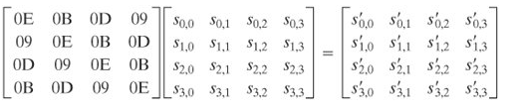
Mustansiriyah University Block Cipher Class: Third Year
Faculty of Engineering Advanced Encryption Standard Course name: Data Encryption
Computer Engineering Dep. Lecturer: Fatimah Al-Ubaidy
AES Block Cipher
The AES Decryption Algorithm:
AddRoundKey:
Add Roundkey transformation is identical to the forward add round key transformation, because the XOR operation is its own inverse.
Inverse SubBytes:
This operation can be performed using the inverse S-Box. It is read identically to the S-Box matrix.
InvShiftRows:
Inverse Shift Rows performs the circular shifts in the opposite direction for each of the last three rows, with a one-byte circular right shift for the second row, and so on.
InvMixColumns:
The inverse mix column transformation is defined by the following matrix multiplication in Galois Field (2⁸):

Slide 9
Video Link
Video of AES
Another video

